Slide 1

ESCAPING VELOCITY
NEAR SPACE NEAR YOU!

Slide 2
INDEX
INSPIRATION FOR DEVELOPING
METHODOLOGY
BENEFITS
TEAM NAME: ESCAPING VELOCITY
DHARANIDHARAN S.A 2020-2024 / KNOWLEDGE INSTITUTE OF TECHNOLOGY
PRANAV DP 2020-2023 / VTM NSS COLLEGE
PRANAVV HARAN N 2021-2025 / SRM SCIENCE AND TECHNOLOGY,KATTANKULATHUR
ASWINN SR 2020-2023 / SRM SCIENCE AND TECHNOLOGY,KATTANKULATHUR
VARSHITHA V 2020-2024 / RNS INSTITUTE OF TECHNLOGY
JAYASOORYA J THE HOLY CROSS MATRICULATION HIGHER SECONDARY SCHOOL

Slide 3
Making a low cost HAB ,and for what purpose it is used
Though we had Two options of using Helium and Hydrogen , by considering all Advantages and disadvantages we concluded with using Helium
And an ingenious idea was put forward that to add a drone with payload .As the balloon bursts, the speed of descent can be reduced by using a drone with high rpm and large blade area. This will not affect the balloon at any cost. So as payload reaches near the surface, we can steer the drone to make it reach a destined location ,if we have prepared the next balloon for flight then it can be done quickly. This can save lot of time and effort.
Other things such as the Size of balloon and parachute, paracord, amount of helium and arrangements of payloads are discussed and confirmed in proper way.
PARACHUTE
PARACORD
CAMERA
GPS
PAYLOAD BOX
MADE OUT OF CARBON FIBRE MATERIALS
NEARLY 50ft
SPOT GEN 3
BALLISTIC PARACHUTES
LIGHTDOW 4000D

Slide 4
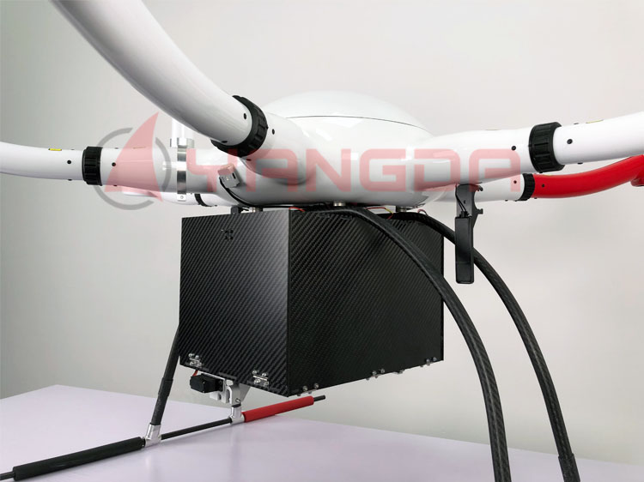
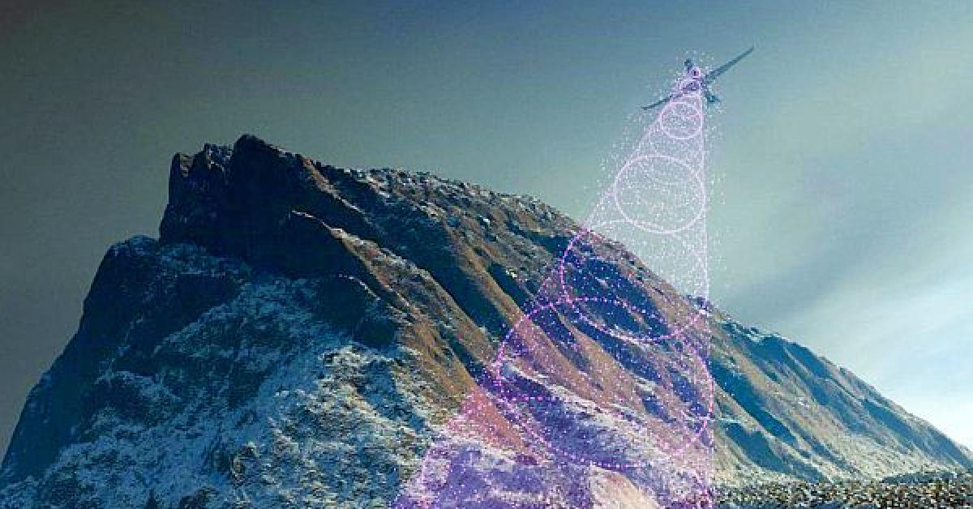
FUTURE ENHANCEMENTS
SO, HOW IS YOUR SOLUTION DIFFERENT?
Our unique way in this common HAB plan is introducing Drone for carrying payloads ,which could reduce the much time. But we have also included the parachute for secondary safety. And even bringing my Payloads to my desired locations.
DRONE
BALL BEARINGS
PAYLOAD BOX
First and foremost point is to fulfil the “space dreamers” dream come true for underprivileged children.
And the main point is to help farmers and save farming , by using this data of weather and other things.
This Digital approach could lift up the farming to next level in future for sure.
The next insight is to make geographical mapping with accurate data for large terrain possible.(Flow in sl.no.07)
Temperature , Windspeed , pressure all these can be calculated and will be given as data.

Slide 5
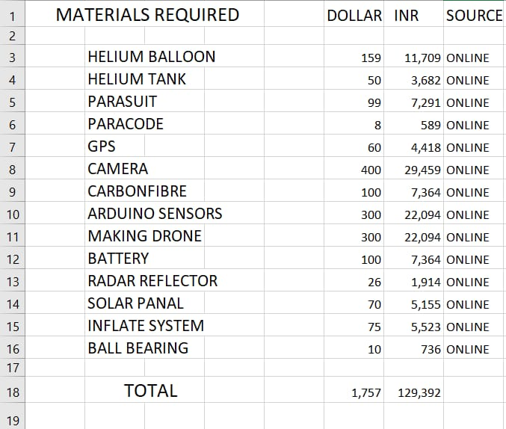
MATERIAL BILL
USD: 1,757 $
INR: 1,29,392/-
DRONE
PAYLOADS

Slide 6

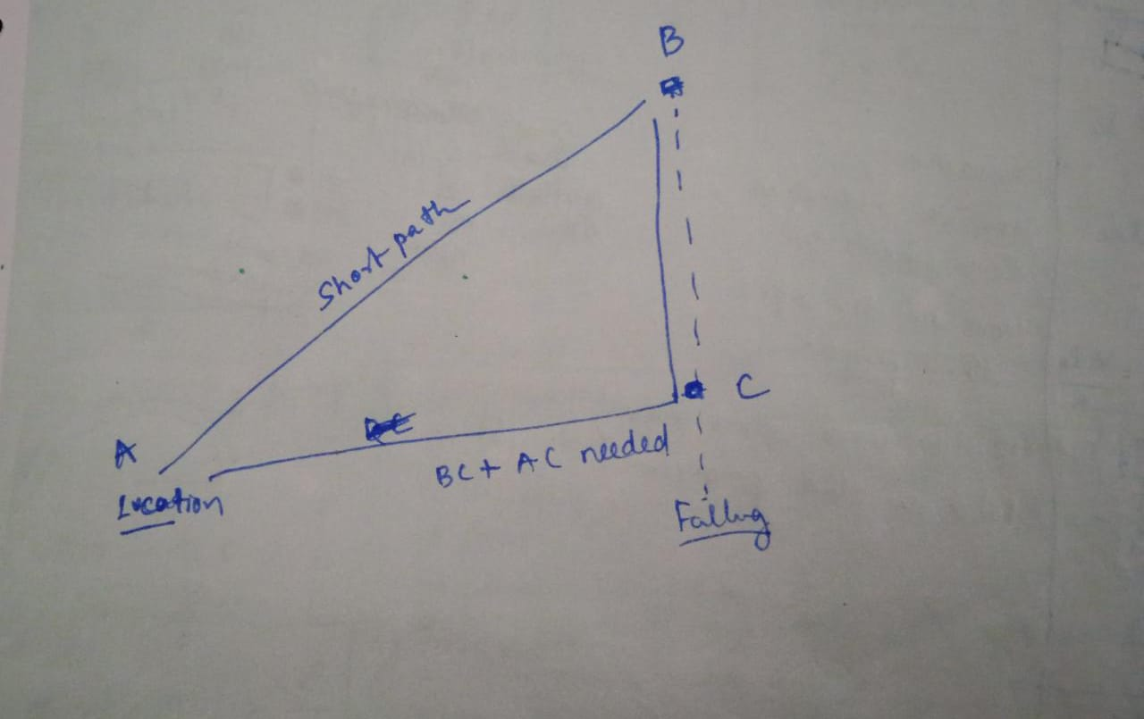
SUBMISSION LINKS
GitHub Link=JayasooryaJeswin/HAB2 (github.com)
Mechanism involved in our HAB

Slide 7
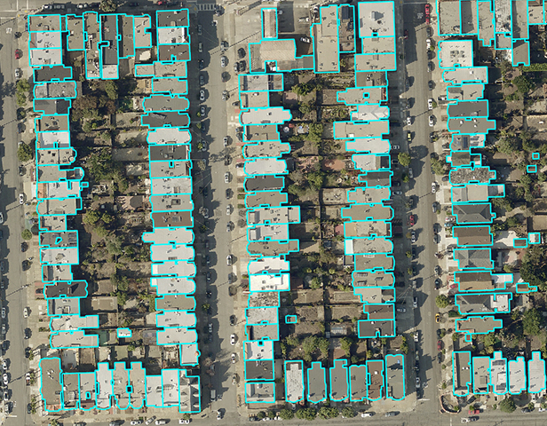
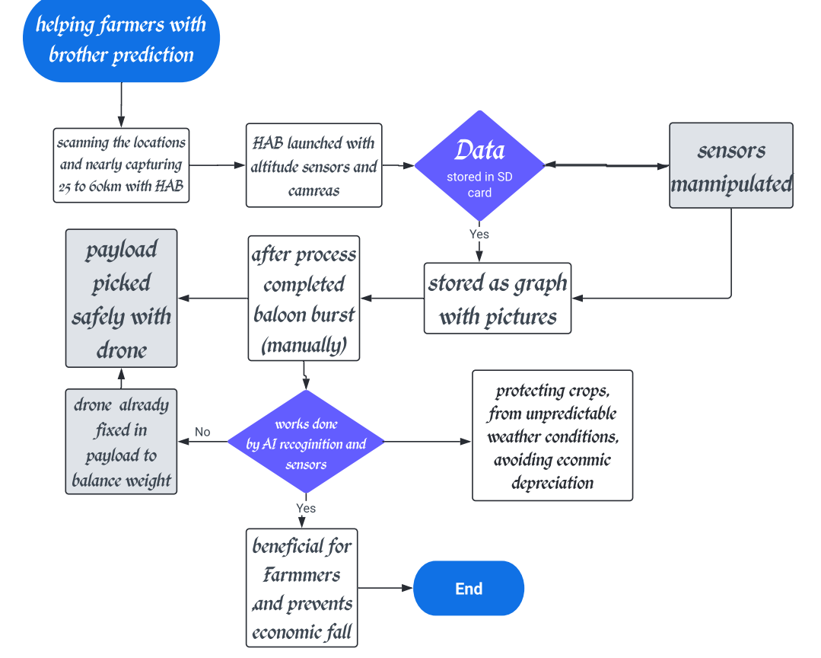
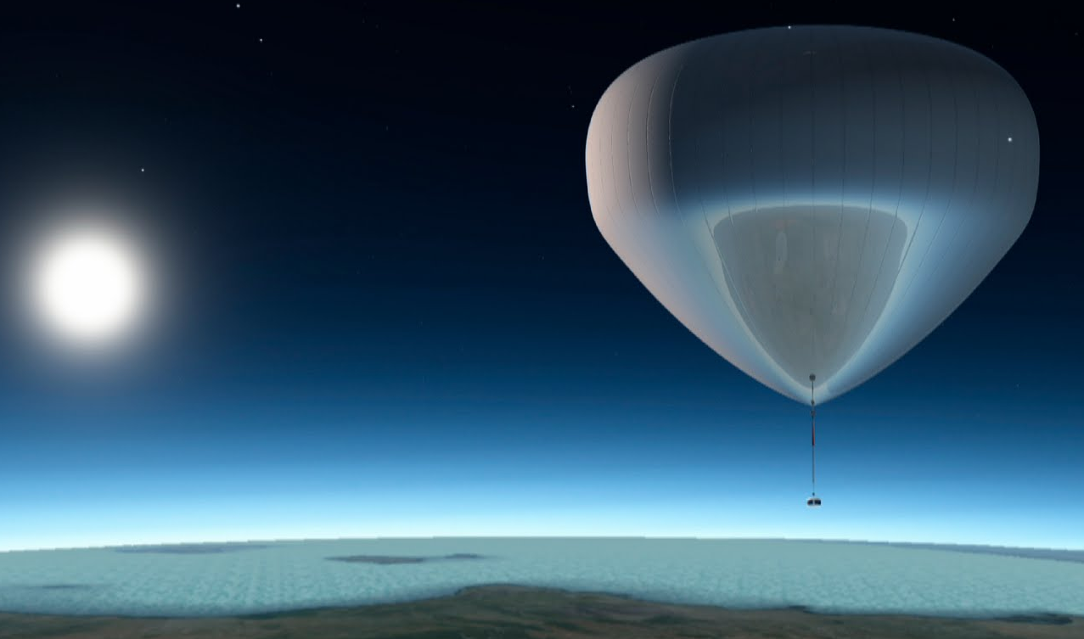
FLOW CHART OF OUR PLAN:
Radiosondes measure atmospheric pressure,temperature,wind speed and also has a radio transmitter to send the data back to ground.
weather

